Slide 1

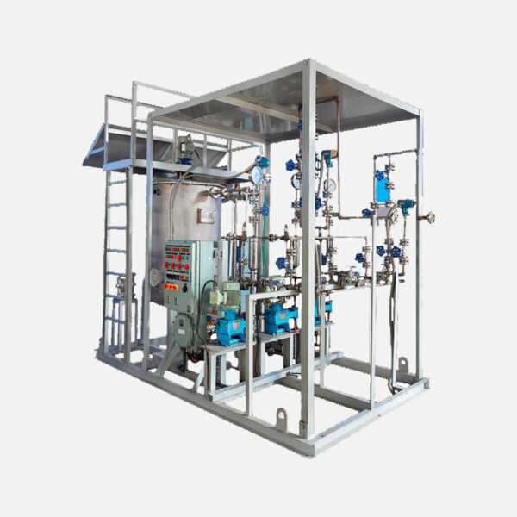
Chemical Injection System

Slide 2
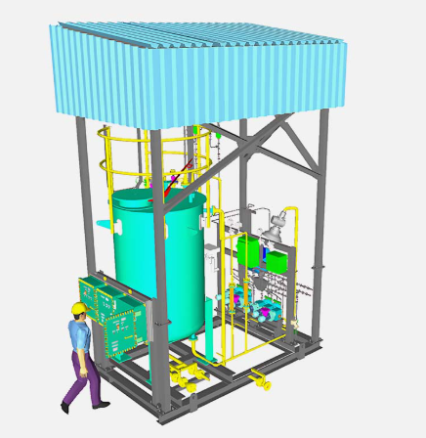
Turnkey Engineering : Fully Integrated and Pre assembled Industrial Chemical Feed Skid. Continuous Performance : Configured with Duty and Standby pump for uninterrupted operations. Safe Handling : Double Contained Chemical skids maximize operator Protection.

Slide 3
Storage and Mixing : Heavey Duty, corrosion resistance PE/FRP material tank equipped with High-performance motorized agitator and automated level alarms to maintain raw solution consistency. Precision Metering : Advance digital electronics diaphragm dosing pump operating in duty/standby configuration. Ensure micro – adjustable, pulsation free dosing streams. Other Accessories : Reliable equipment of pulsation dampener, calibration pot, level measurement instrument, valves strainers, PRV etc, to complete the skid and operatable and safe system.

Slide 4
Typical CIP Arrangement

Slide 5
INDUSTIES WE SERVED
Water and Waste Water Treatment Sector
Fertilizer Plants & Chemical Industries
Oil and Gas Industries
Chemical Industries
Others all type of Customized application

Slide 6
Ready to Optimize
Let’s Collaborate with our team a custom dosing skid tailor made for your specific Industrial application with chemical properties and safety guideline.
THANK YOU

